Slide 1
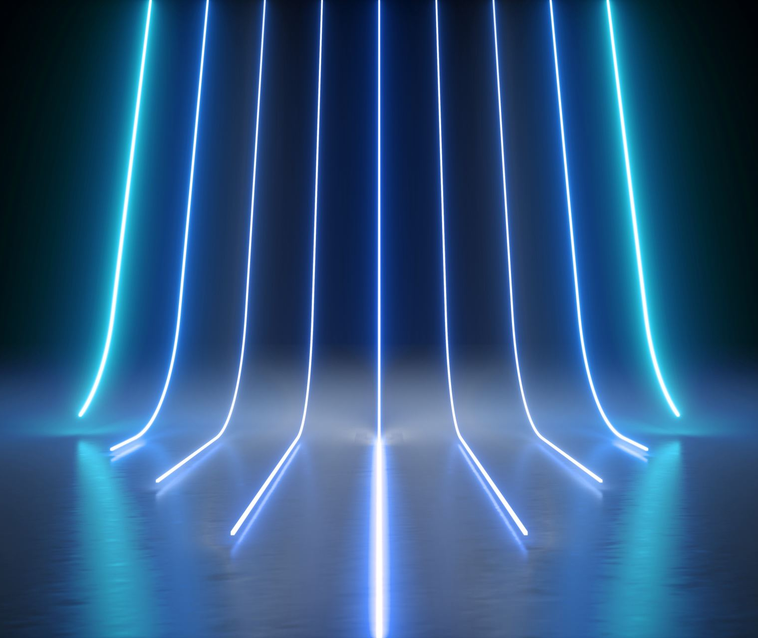
Algoritmi de sortare
Proiect prezentat de Maftei Valentin - Vasile

Slide 2
Radix sort
Complexitate : Average: O(d(n+k))
Worst-case: O(log_{b}(mx)(n+b))

Slide 3
Merge sort
Complexitate: Average: O(nlogn)
Worst-case: O(nlogn)

Slide 4
SHELL SORT
Complexitate: Average: O(n^4/3)
Worst-case: O(n^3/2)

Slide 5
Quick sort
Complexitate: Average: O(nlogn)
Worst-case: O(n^2)

Slide 6
Heap sort
Complexitate: Average: O(nlogn)
Worst-case: O(nlogn)

Slide 7
Rezultate teste:
Algoritm: | Timpi 10 ^ 2
Radix sort: | 6.58e-05
Merge sort: | 0.0003349
Shell sort: | 0.0001047
Quick sort: | 0.0001292
Heap sort: | 0.0001794
STL: | 0.000129

Slide 8
Algoritm: | Timpi 10 ^ 4
Radix sort: | 0.0010819
Merge sort: | 0.0028435
Shell sort: | 0.0016493
Quick sort: | 0.0010404
Heap sort: | 0.0017086
STL: | 0.0012666

Slide 9
Algoritm: | Timpi 10 ^ 5
Radix sort: | 0.0096577
Merge sort: | 0.0322242
Shell sort: | 0.0233680
Quick sort: | 0.0117696
Heap sort: | 0.0215546
STL: | 0.0154120

Slide 10
Algoritm: | Timpi 10 ^ 6
Radix sort: | 0.0968536
Merge sort: | 0.3039110
Shell sort: | 0.2851470
Quick sort: | 0.1454050
Heap sort: | 0.2744060
STL: | 0.1609050

Slide 11
Algoritm: | Timpi 10 ^ 7
Radix sort: | 0.9382990
Merge sort: | 3.0332600
Shell sort: | 3.9109900
Quick sort: | 3.9145700
Heap sort: | 4.2564900
STL: | 1.8204000

Slide 12
Algoritm: | Timpi 10 ^ 8
Radix sort: | 0.9382990
Merge sort: | -
Shell sort: | 286.0470
Quick sort: | 94.5974
Heap sort: | -
STL: | -

Slide 13
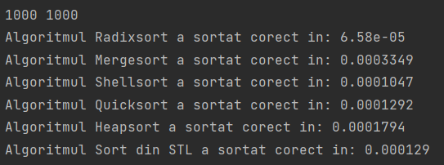
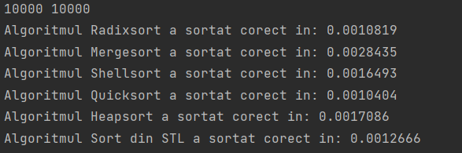
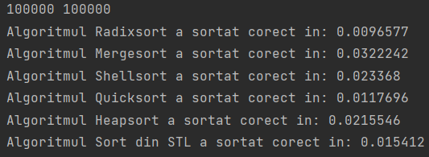
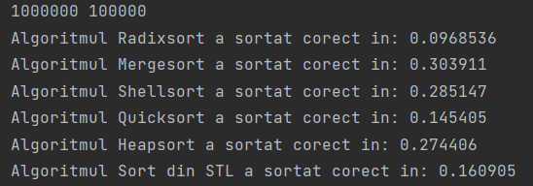
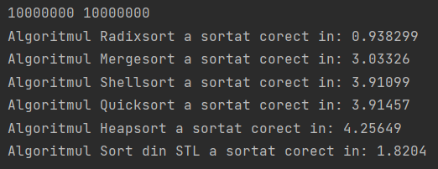
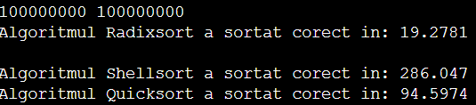
Proof:

Slide 14
Radix Sort este cel mai eficient (in general);
Radix > STL > Quicksort > Heapsort > Shellsort
Conlcuzie:

